Slide 1
Airport Roleplay
☺

Slide 2


Slide 3
AIRPLANE
☺

Slide 4
WINGS
AIRPLANE
☺

Slide 5
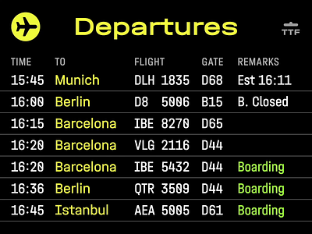

Salidas

Slide 7
Llegadas

Slide 8
Arrivals

Slide 9
Departure time
arrival time

Slide 10
CUSTOM
CONTROL

Slide 11
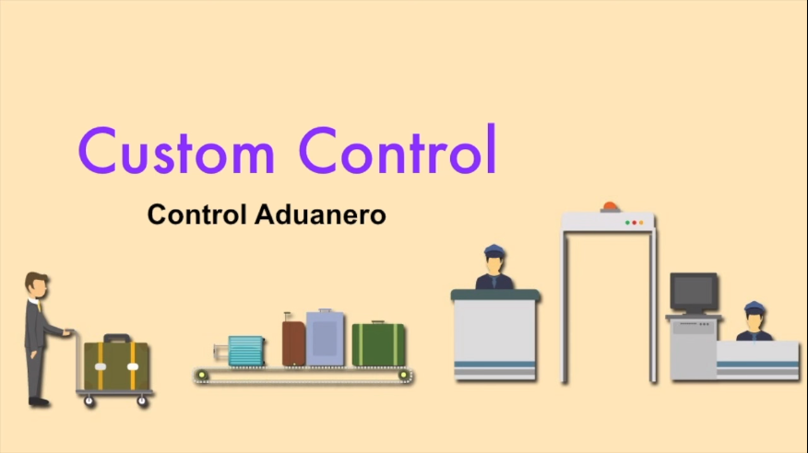

Slide 12
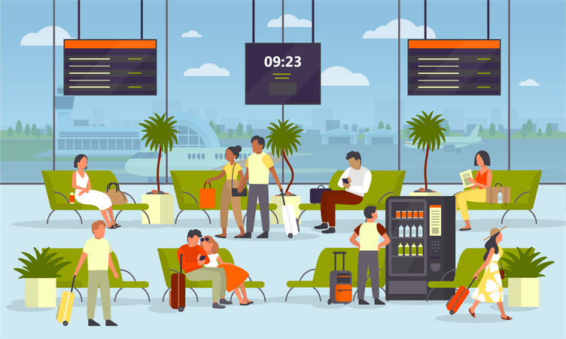

Slide 13
Waiting room
Boarding room

Slide 14
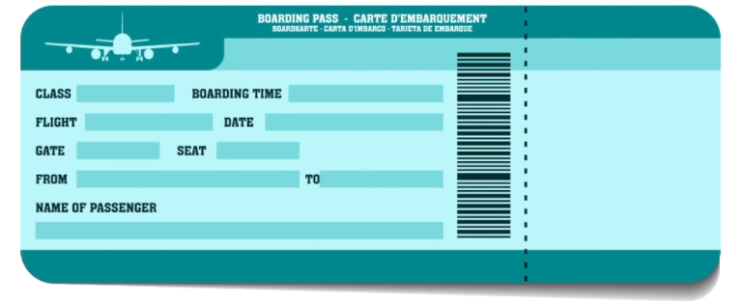

Slide 15
Flight Status
Delayed | Retrasado
On time | A tiempo
replaced | Re puesto

Slide 16
Seats
Aisle
Seat
Window
Seat

Slide 17
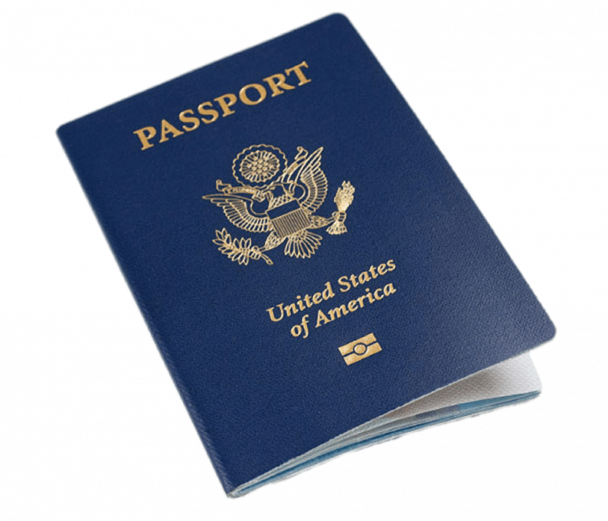
Passport

Slide 18
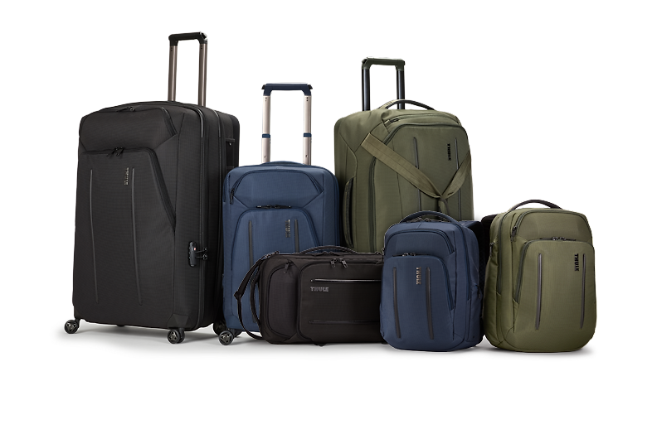
Luggage

Slide 19
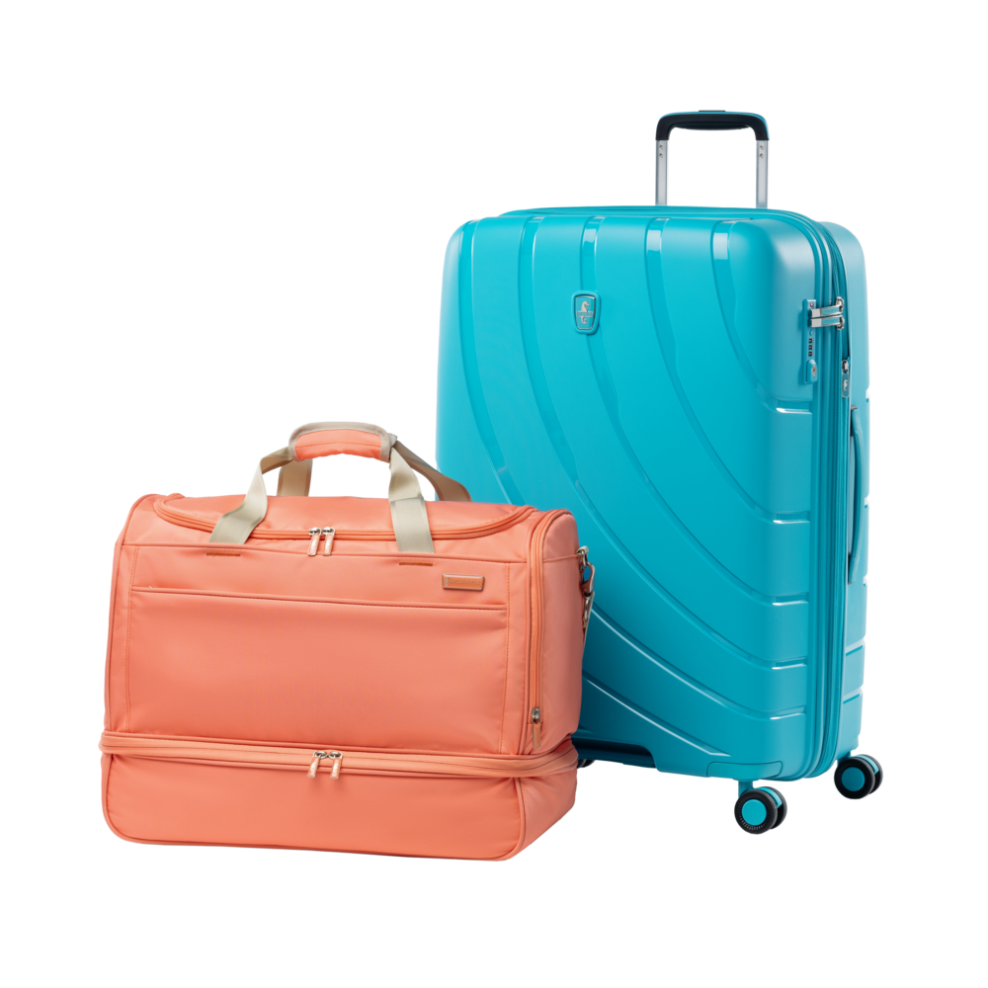
Carry –on Luggage

Slide 20
Despegue = Take off

Slide 21
Aterrizaje = Landing

Slide 22
stewardess

Slide 23
Azafata
Stewardess
ESTURDES

